Slide 1
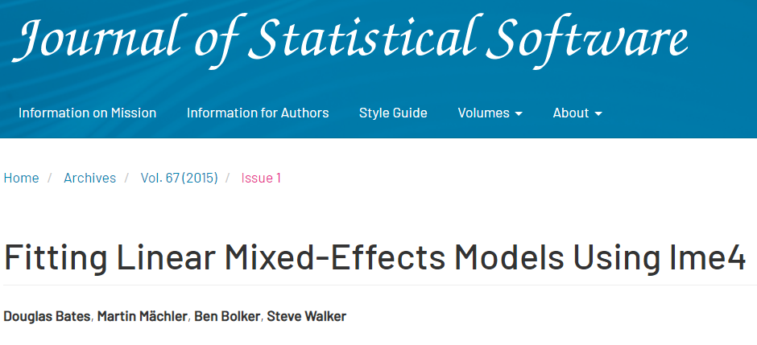
Hierarchical / multi-level modelling with

Slide 2

The basics

Slide 3
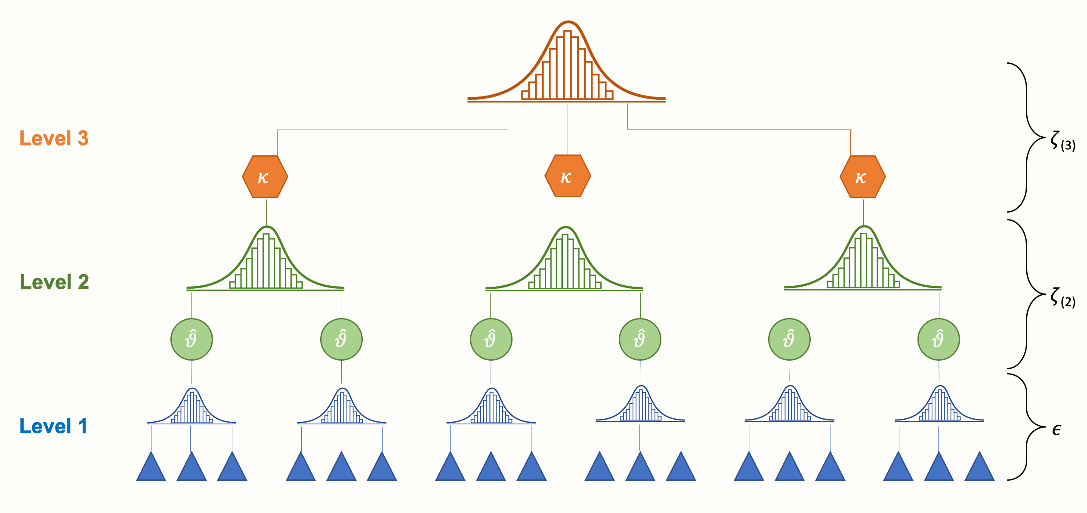
Hierarchical modeling (MLM)
3
Notes:
Illustration from https://bookdown.org/MathiasHarrer/Doing_Meta_Analysis_in_R

Slide 4
Why not ignore it?
Assumption of linear models: independence of residuals → dependence (i.e. clustering) gives wrong SEs … and thus wrong p-values
If interested in group-differences (e.g., countries): MLM alternative to lots of dummy variable terms
Notes:
Intuition: related observations give us much less information, particularly about higher-level predictors

Slide 5
Key concepts
Random vs fixed effects
Fixed effects are assumed to be independent (e.g., age & gender)
Random effects are sampled from a distribution (i.e. similar to each other, e.g., country-dummies) → estimated with ‘shrinkage’
Random intercepts: different intercepts between clusters
Random slopes: different slopes between clusters (c.f. interaction terms)
Intraclass correlation (ICC): similarity within each class
5

Slide 6
Examples

Slide 7
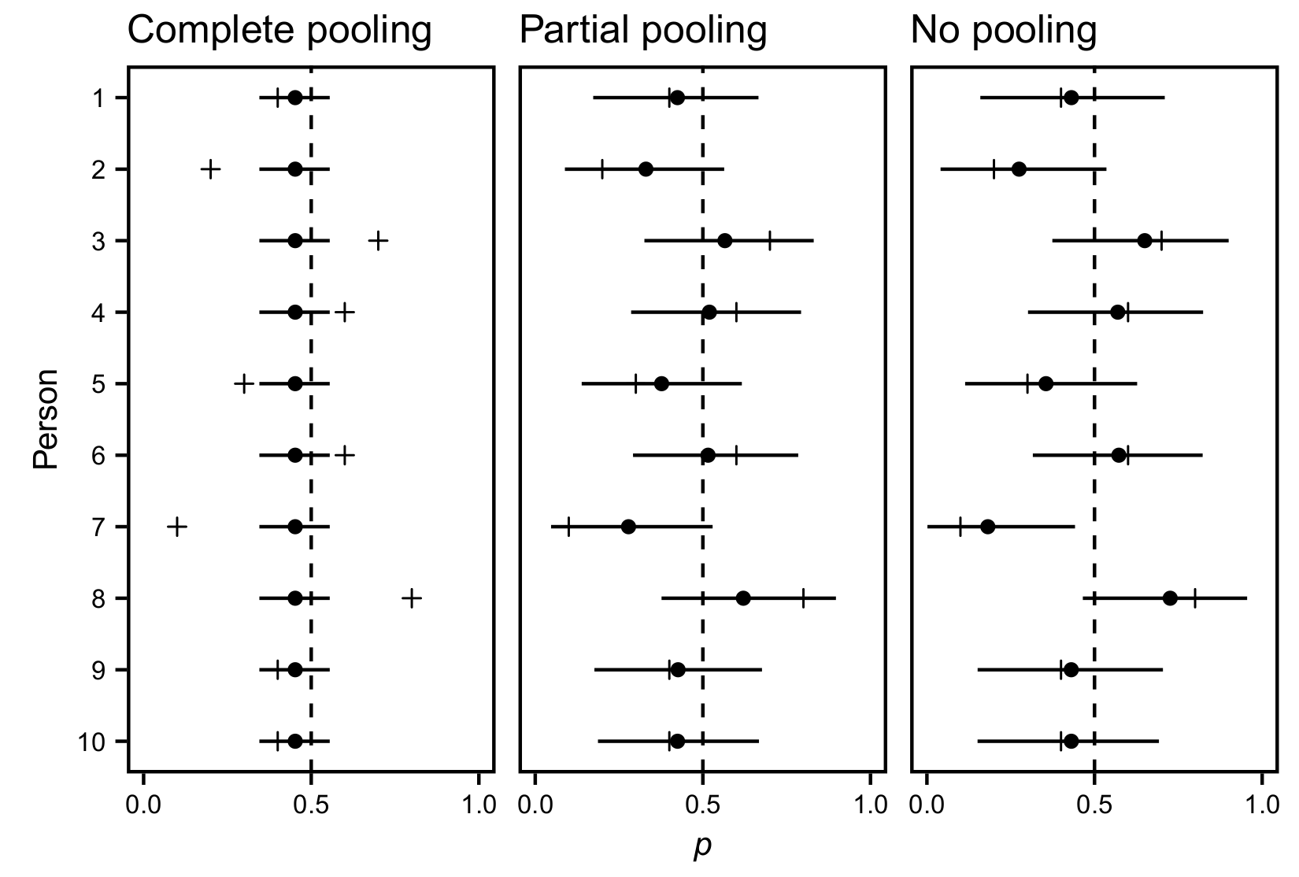
People’s “success” when tossing a coin
→ Multi-level modeling deals with multiple comparison issues
7

Slide 8
Working mothers
What is the link between having a young child (<12 years) and working hours?
ESS data clustered into countries

Slide 9
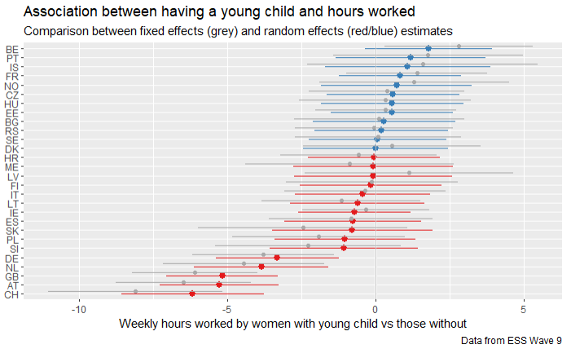

Slide 10
Your Turn 1
In 03-MLM-Exercises.Rmd:
Import ess_work.RDS with the code provided
Explore visually whether health predicts happiness – and how that differs between countries
03:00
10

Slide 11
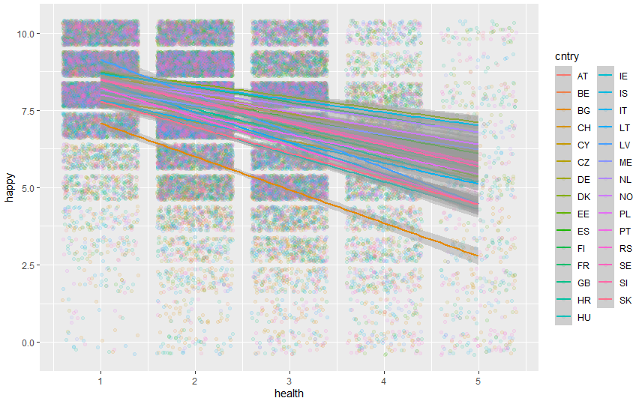
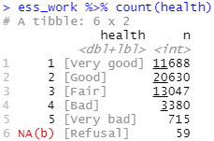

Slide 12
Estimating multi-level models: random intercepts
lm(IV ~ DV, data) →
lmer(IV ~ DV + (1|group), data)
Fixed effect
From lme4 package – estimates linear mixed effect models
Random intercepts for group variable (NB: 1 = intercept)

Slide 13
Your Turn 2
Test whether health predicts happiness –
without (lm) and with (lmer) a random intercept for countries
have a look at each summary() and identify the regression coefficient and its significance
05:00
13

Slide 14
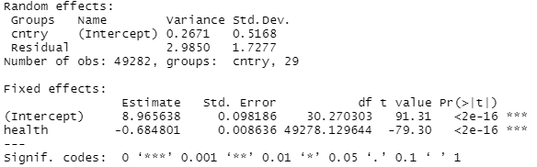



With random intercepts
lm(happy ~ health, ess_work) %>% summary()
lmer(happy ~ health + (1|cntry), ess_work) %>% summary()
NB: significance testing is problematic here because df need to be adjusted – lme4 does not provide any p-values. Added by lmerTest, can read more here.
14

Slide 15
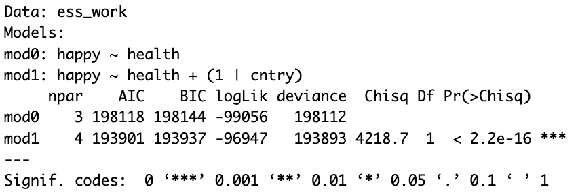


Do we need these intercepts?
Strategy: model comparison
mod0 <- lm(happy ~ health, ess_work)
mod1 <- lmer(happy ~ health + (1|cntry), ess_work)
anova(mod1, mod0)
15
Notes:
Model comparison always risky – might overfit to the data – so should also always report theoretically motivated model.
However, ok when clustering is only nuisance variable in any case.

Slide 16
Estimating multi-level models: random slopes
lm(IV ~ DV, data) →
lmer(IV ~ DV + (DV|group), data)
From lme4 package – estimates linear mixed effect models
Random slopes for DV per group

Slide 17
Your Turn 3
Add a random slope for health in each country
Add gender as a fixed effect
Test whether that random slope is significant
04:00
17

Slide 18
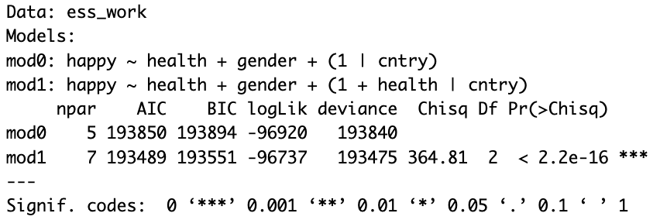
Do we need these slopes?
Strategy: model comparison
mod0 <- lmer(happy ~ health + gender + (1|cntry), ess_work)
mod1 <- lmer(happy ~ health + gender + (1 + health |cntry), ess_work)
anova(mod1, mod0)
18
Notes:
Model comparison always risky – might overfit to the data – so should also always report theoretically motivated model.
However, ok when clustering is only nuisance variable in any case.

Slide 19
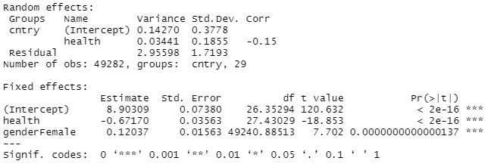


With random slopes
lmer(happy ~ health + gender + (1 + health |cntry), ess_work) %>% summary()
19

Slide 20
Your Turn 3a
Visualise the random effects
Follow the instructions – remember that ?function opens the help
04:00
20

Slide 21

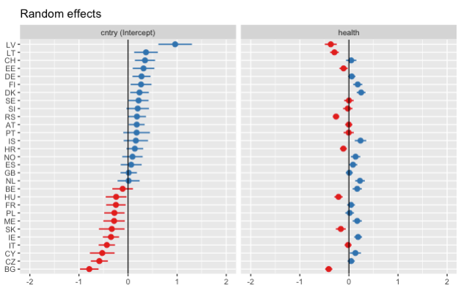
Visualising random effects
plot_model(mod, type = "re", sort.est = "(Intercept)") + geom_hline(yintercept = 0)
21

Slide 22
Uses of multi-level models
Dealing with participants clustered in, e.g., organisations
Analysing repeated measures (nested in participants)
Accounting for separate items, vignettes, manipulations (reduce need for averaging – tutorial)
Can use nested (e.g., organisations in countries) and parallel (e.g., vignettes and participants) clusters
22

Slide 23
Your turn 4: Bringing it all together & cross-level interactions
Are men’s views on working mothers linked to how much mothers actually work?
Follow the steps in the Rmd file.
07:00
23

Slide 24
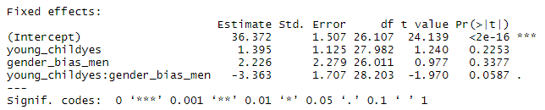
Cross-level interactions … need random slopes
ess_work %>% filter(gender == "Female") %>%
lmer(wkhtot ~ gender_bias_men * young_child + (young_child | cntry), .) %>%
summary()
Without random slopes, p-value much lower – but model based on problematic assumption that gender_bias_men explains all slope variation
See Heisig & Schaeffer (2019)
24

Slide 25
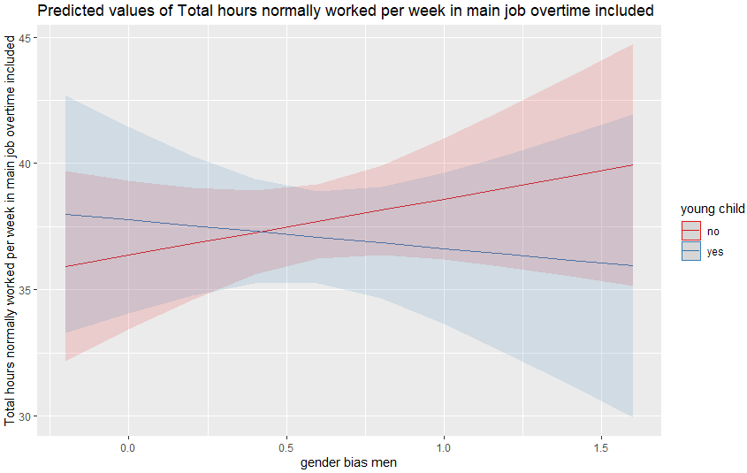
Visualising the interaction
plot_model(mod_int, type = "int")

Slide 26
Hierarchical / multi-level modelling with
and

